Slide 1



Welcome!
CSP West Midlands Regional Network:
Empowering our communities:
Local innovation to inspire the profession
@WestMidlandsCSP
#WMCSP

Slide 2
Housekeeping
Please feel free to tweet using @WestMidlandsCSP #WMCSP
Pictures will be taken of today for use in Frontline and on social media – if you don’t want your pictures taken please inform a member of CSP staff
If you would like to get more active in the region you could think about joining our core team for 2025 – please speak to me or one of the members of the core team today if you are potentially interested
Make the most of the networking opportunities today – you may also want to sign up to be a mentor or mentee using the CSP’s mentoring platform: https://www.csp.org.uk/professional-clinical/leadership/csp-mentoring-scheme
And finally a call for members to join our West Midlands Peer-to-Peer Diversity Network which is a great opportunity to explore in more depth and celebrate diversity in the region: https://www.csp.org.uk/icsp/west-midlands-diversity-peer-peer-network

Slide 3
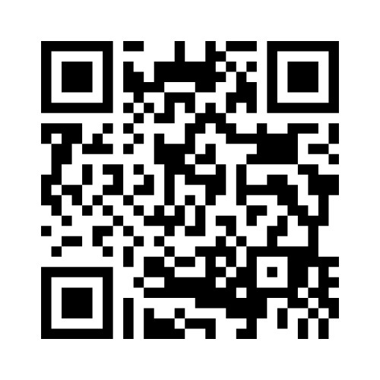
Quick poll
So that we can chart progress through the day we would like to capture your thoughts via menti.com – please answer a few questions to start the event by visiting menti.com and entering the code
4215 4020 or scan this QR code

Slide 4
Agenda
10 | Opening speech CSP Chief Executive John Cowman
10:30 | Solihull, QE, ROH and Versus Arthritis and UHB Community Appointment Day Initiative
11am | Break
11:15 | Catherine May (Psychological safety and intro to after lunch workshop)
12:15 | Lunch
1:30 | QI workshop with Catherine May
2:30pm | Summary and actions
3:30 | Finish

Slide 5

Connect with us

Slide 6

John Cowman
CEO, The Chartered Society of Physiotherapy

Slide 7
West Midlands Regional Network
November 26th 2024
John Cowman

Slide 8
One word to describe the most important trait of leadership…..
Leadership

Slide 9
Harvard Business Review
‘Ability to influence others’
Leadership

Slide 10

the power to have an important effect on someone or something
Influencing

Slide 11
one word to describe the most powerful way to influence……..
Influencing

Slide 12
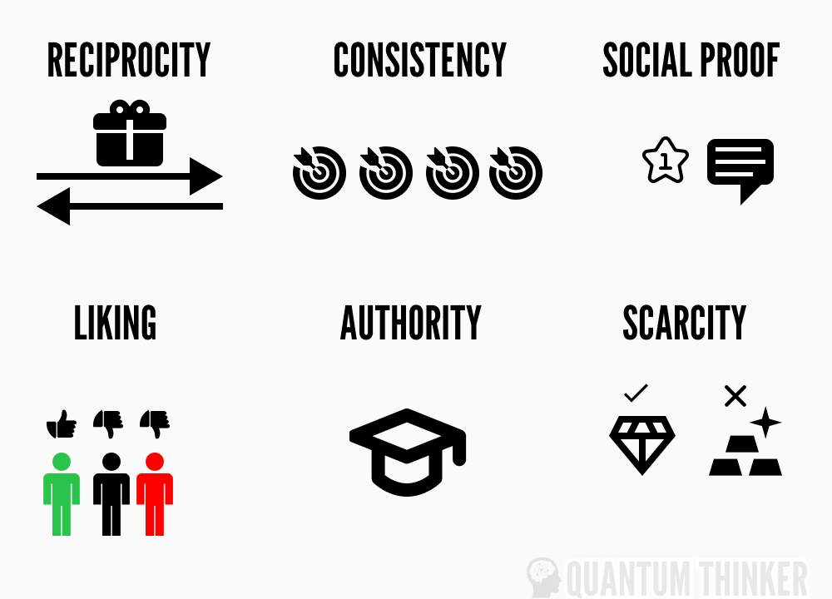
Cialdinis 6 Principles of Persuasion
Influencing

Slide 13
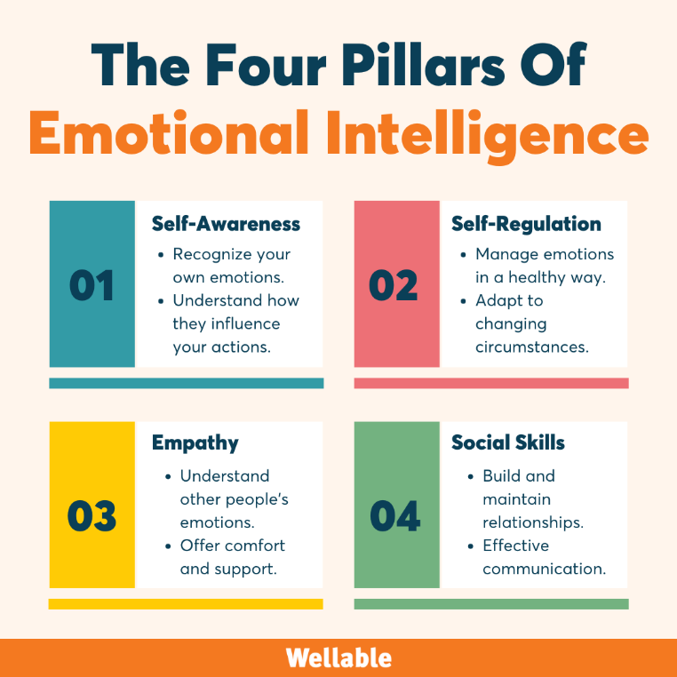
the ability to manage both your own emotions and understand the emotions of people around you
Emotional Intelligence

Slide 14
Seek first to understand and then be understood
Know Yourself

Slide 15

Psychometrics
Practical Hint 1

Slide 16
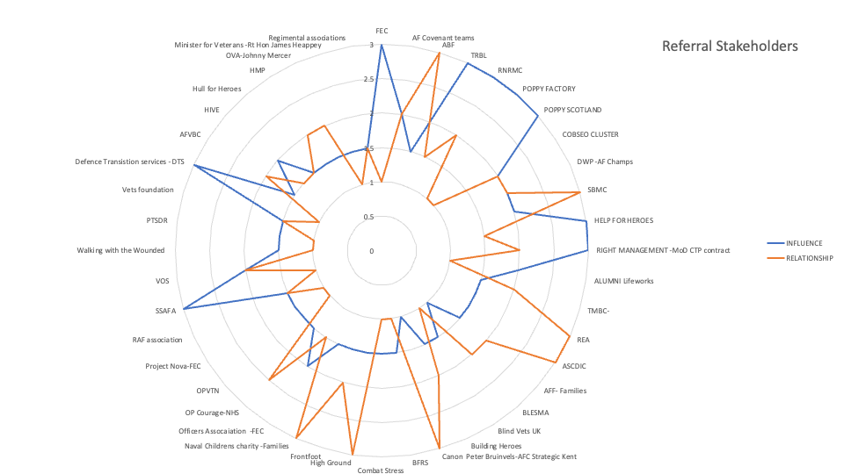
Know Your Audience

Slide 17
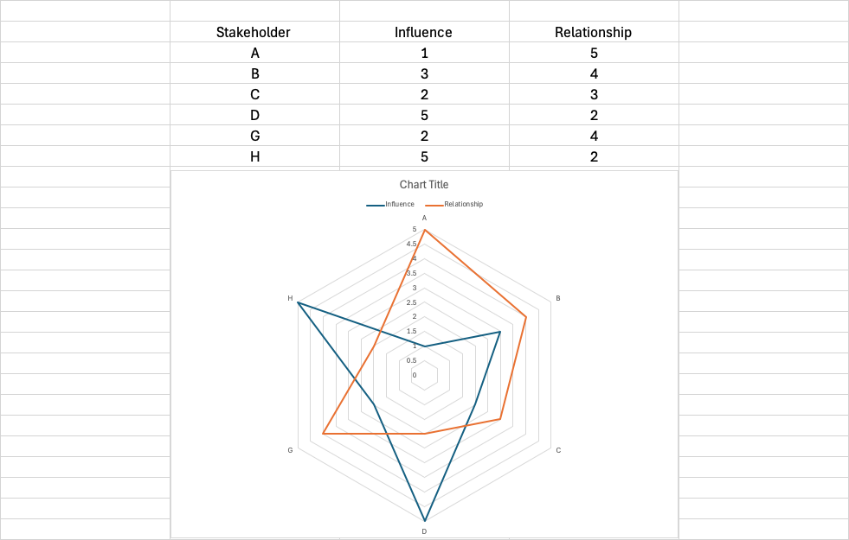
Stakeholder Mapping
Practical Hint 2

Slide 18

Be prepared
Know Your Subject

Slide 19
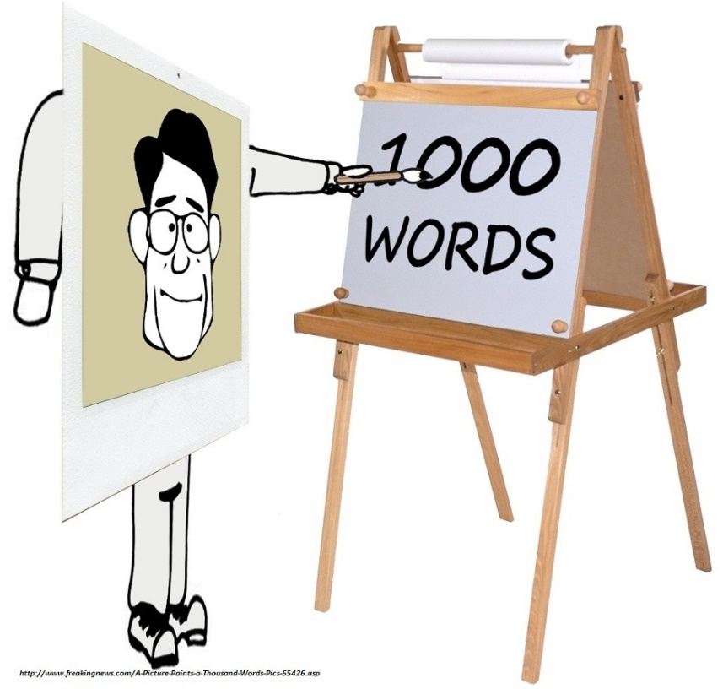
Gather and Use Data
Practical Hint 3

Slide 20

Tell the Story

Slide 21
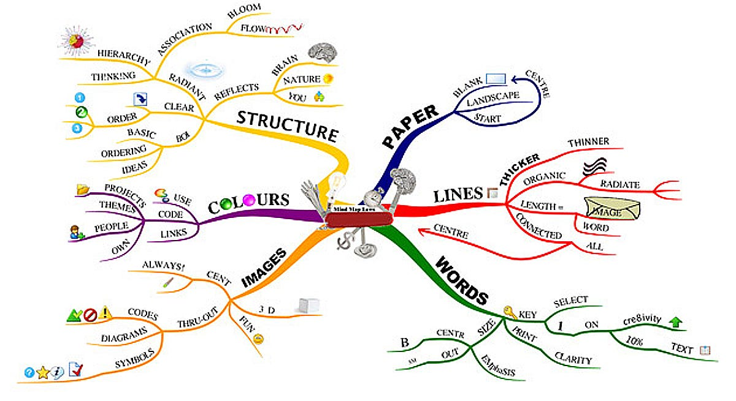
Story Boards
Practical Hint 4

Slide 22
^{www.csp.org.uk}

Slide 23

Solihull, QE, ROH and Versus Arthritis and UHB
Community Appointment Day Initiative

Slide 24
Break
Resume at 11:15

Slide 25
Catherine May
Psychological Safety session

Slide 26
Networking lunch
Resume at 1:30

Slide 27
QI workshop
With Catherine May

Slide 28
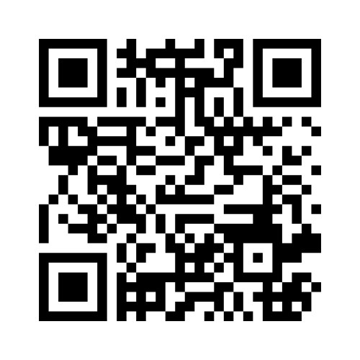
Quick poll
We would like to capture your thoughts and feedback via menti.com – please answer a few questions by visiting menti.com and entering the code 1484 9051 or scan this QR code

Slide 29
Follow up event….
We will be running a follow-up event to this one (online) with Catherine May
on Monday 19 May 2025, 1pm
Details to book will be shared soon via regional emails from the CSP and on our social media accounts

Slide 30


