Slide 1
Practice Based Learning – Innovation or time for business as usual?
Dr Gill Rawlinson Director @GillRPhysio
CSP Council member

Slide 2
PrBL in Physiotherapy-the basics …
Language not ‘clinical placement’
‘1000’ hours – CSP requirement
HCPC does not set hours.
HCPC Standards new for Sept 23- outcomes based
Why innovate ?-Capacity-Quality v quantity
Tarif-£100 per students per week - do you know approx. where yours go?!
Private, Independent and Vol Sector (PIVO)
Myths eg who can supervise/what activities etc ?

Slide 4
Principle 2-PBL happens everywhere- Four Pillars

Slide 5
Leadership & Education placement
6 weeks Uni of Salford 4th Yr PT
Sam Hewitt
Previous skills –Marketing
Hybrid in-person/ WAH
Teaching & learning/ assessment
Service users groups
Interprofessional education
Senior executive
Enhanced Clinical Practice project

Slide 6
Sam’s perspective

Slide 7
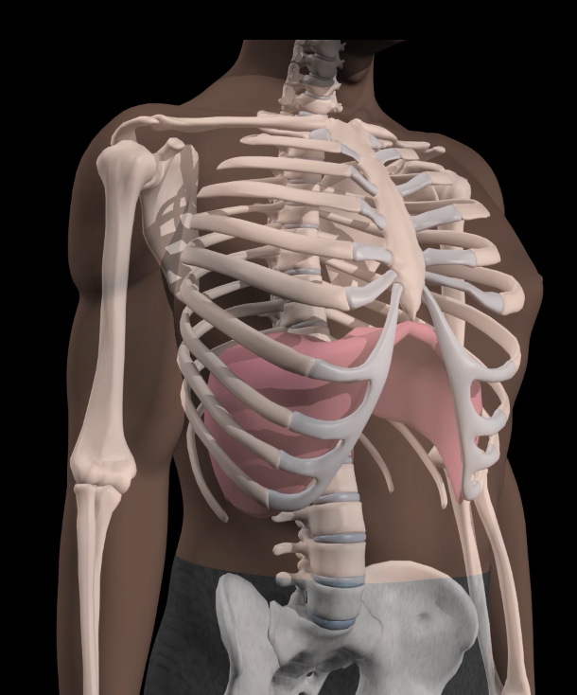
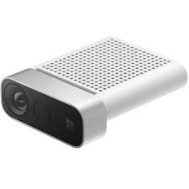
Student research placement
Details of the placement
The placement was for 6 weeks, full time
The following activities were undertaken:
Literature review
Assisting with laboratory data collection on a project aimed at creating a real-time biofeedback system for breathing (see image opposite)
Helping to recruit participants for a study into knee osteoarthritis
Creation of video-based patient educational materials
Student gained an understanding of research governance, literature searching, gaining ethical approvals and biomechanical data collection
Perceptions
Student: Very positive experience, opened her eyes to the world of research and motivated desire to work in research in future
Staff: After some training the student worked independently to make an important contribution to the research team. She was invited back after placement to work in paid role to continue supporting the researchers.

Slide 8
Research Placements
I thoroughly enjoyed my placement with Professor Steve Preece and the research team as it allowed to me gain insight into another pillar of Physiotherapy practice, an area I am now keen to explore off the back of this placement.
I worked across a few projects, and was given the opportunity to stay on for paid work until the end of my degree, which I was extremely pleased about! The skills I gained from this placement really helped my final year research project where I received a 1st in my study protocol poster. I would recommend physiotherapy students to branch out and try a research placement to gain further insight into the meaning of ‘evidence based practice.’

Slide 9
Practice-based learning uses flexible, appropriate and supportive models of supervision and delivery
Principle 4
#CSP_RCOT_PBL

Slide 10
Peer supervision models
Taking more than one student at once
Peer learning
CLIP models -Clinical placement supervision models | NHS Employers
Barriers –space / time , planning / supervision time
Opportunities – increase capacity, improved student experience, peer support, embed in team, team development, enhanced patient care, Interprofessional education
Notes:
PARP documentation to be completed 4-weeks prior to PARP date for review by a representative of the school, e.g., ADA or Quality Lead, etc., as well as the QMO. Dean of School, or nominated representative, recommends (or doesn't) the academic case for approval by completing the School Academic Approval form (SAA).

Slide 11
Practice-based learning is designed with a whole team approach
Principle 5
#CSP_RCOT_PBL

Slide 12
Team supervision – embed students in our teams
Developing Education pillar in workforce at all levels - supervision models, teaching and learning supp workers, B5-9
Enhanced clinical practice- an enabler?
Reduce weight of responsibility on single person
Part time
placements?

Slide 13
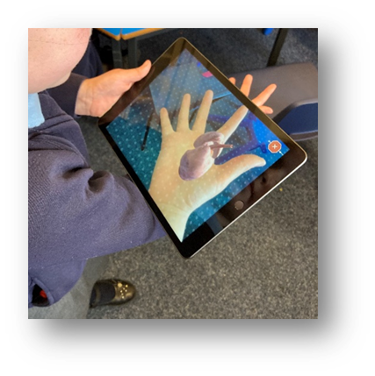
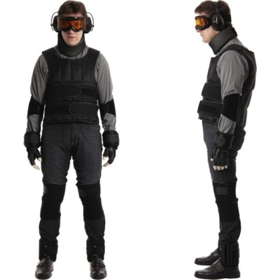
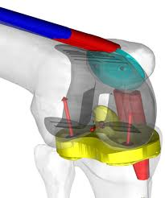
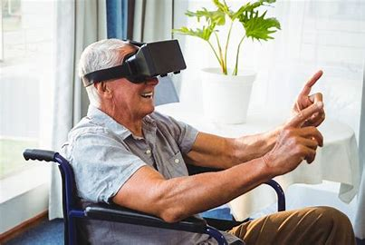
Simulation -What is it?
“Simulation is a technique to replace or amplify real experiences with guided experiences, often immersive in nature, that evoke or replicate aspects of the real world in an interactive fashion” (Gaba, 2004, p.i2)
Notes:
These images show examples of simulation-based education:
Clockwise from top left:
1. Age suits – immersive experiential age simulation (empathy development)
2. Simulation with embedded human simulated patient (SP)
3. Augmented reality heart (used for visualisation)
4. Virtual knee joint
5. Virtual reality (VR) used for rehabilitation

Slide 14
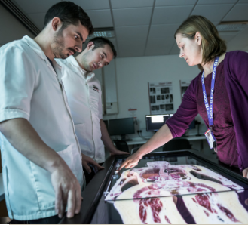
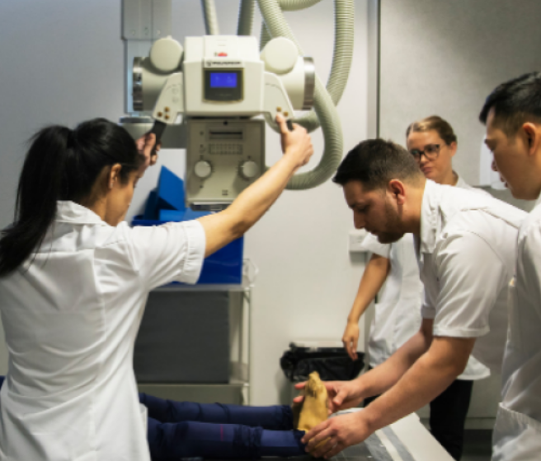
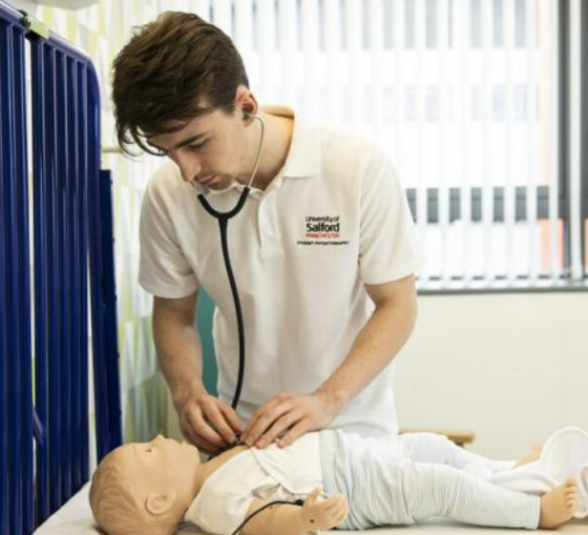
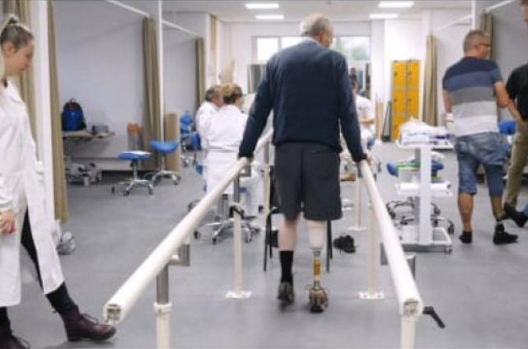
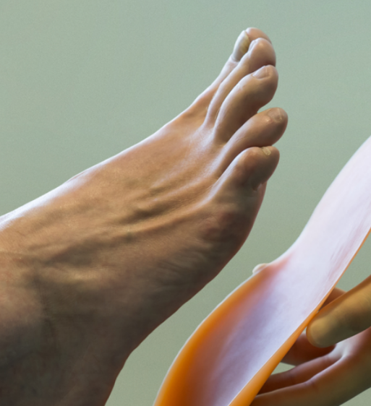
‘Education providers have flexibility to consider using simulation where they feel it can be meaningfully applied to deliver a quality practice-based learning experience’
(HCPC, 2021)
Notes:
https://www.hcpc-uk.org/education-providers/updates/2021/using-simulation-to-support-practice-based-learning/

Slide 15
Simulation
Can simulation replace Practice based learning ???.......
Difficult scenarios?
Placement preparation ? Deep immersive learning ?
Replacement or duplication?

Slide 16
Practice-based learning environments must be inclusive and welcoming to all
Principle 3
#CSP_RCOT_PBL

Slide 17
EDI –student experience
Quality learning experiences-PARE evaluations
Discrimination / CPAF –role of simulation to prepper for difficult scenarios ?
Student experiences on placement- attainment gap/ discrimination / unconscious bias .
Notes:
QMO meeting with proposer / programme team to discuss the process, requirements, approximate timelines, etc. Possibly resulting from a market insight analysis (Marketing - Kate Costello)
Proposer, programme team / directorate complete PBC1 form and submit to School Executive for review.
Programme team request the market insight:
High-level MI - establish whether there’s a market / identify competitors - goes to School Exec
Not a formal requirement of the school exec but can be referred to in the PBC1.
School Executive considers whether to proceed with the development of the new programme.
If approved, the programme business is added to the Operational Plan.
School Exec is approving the concept - can be a working title at this point.
Better to have a firm title for the purposes of marketing, etc.

Slide 18
Practice-based learning is evaluated; capturing data to drive improvement and demonstrate impact
Principle 7
#CSP_RCOT_PBL
Notes:
data to drive improvement and demonstrate impact

Slide 19
How do we move this away from Innovation to BAU?
What are the enablers?
What are barriers ?
What could you and your team need to do next?
What’s good about your placements? What could be improved ?
Do you know a team that don’t take students that could?

Slide 20
Placements are a shop window for your area/ speciality-inspire the future workforce !
“Whether the placement involves providing rehabilitation, leading a service, researching new insights or supporting learners to grow, the breadth of career possibilities available could inspire and shape our future workforce”

Slide 21
Resources/ references
CSP practice based learning webpages
Including videos https://youtu.be/qk1VUc9HP8s
Condon, C., Lam, W.T., Mosley, C. and Gough, S. (2020) A systematic review and meta-analysis of the effectiveness of virtual reality as an exercise intervention for individuals with a respiratory condition. Advances in Simulation, 5, pp.1-17
Gaba, D.M. (2004) The future vision of simulation in health care. BMJ Quality & Safety, 13 (suppl 1), pp.i2-i10.
HCPC (2021) Using simulation to support practice based learning [Online] [Available here] https://www.hcpc-uk.org/education-providers/updates/2021/using-simulation-to-support-practice-based-learning/

Slide 22
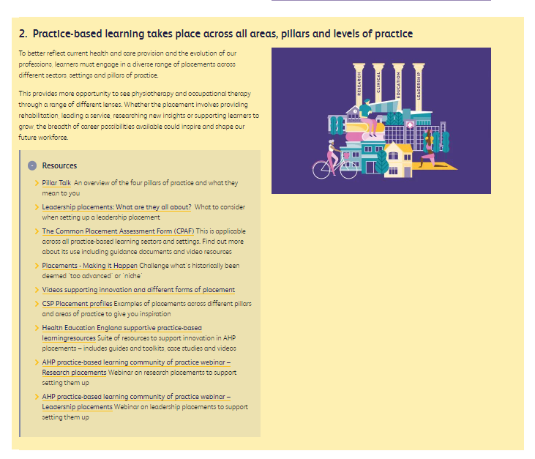
https://www.csp.org.uk/publications/principles-practice-based-learning
https://www.rcot.co.uk/node/5234
#CSP_RCOT_PBL

Slide 23
GM Academic Careers Event
University of Salford
23rd May 2023
6-8pm
Register now and come along !

Slide 24
Thank you!

