Slide 1
Physiotherapy workforce in the North West: drivers, trends, challenges and opportunities
Gareth Cornell
Regional Workforce Lead (AHP), NHS England – North West (Workforce, Training & Education)
gareth.cornell@hee.nhs.uk

Slide 2
Introduction
What we’ll talk about today…
Key policy drivers and the context for physiotherapy workforce
Evolution of Integrated Care Systems
Current profile of physiotherapy workforce in the region
Workforce enablers
CSP North West Regional Network May 2023

Slide 3
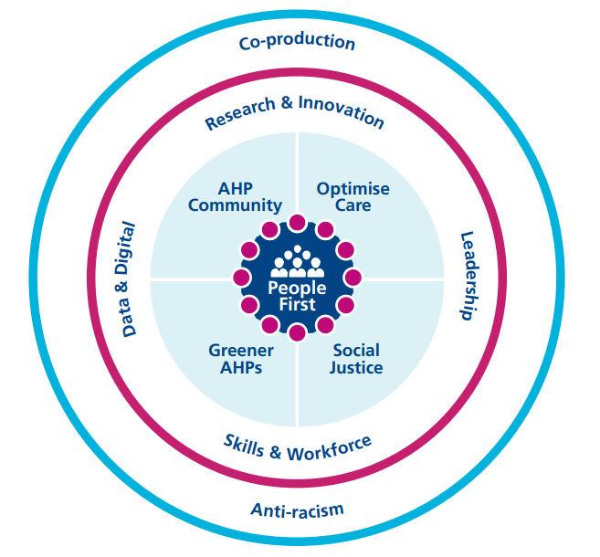

AHPs Deliver
The Allied Health Professions (AHP)for England: 2022 to 2027 AHPs Deliver
CSP North West Regional Network May 2023

Slide 4
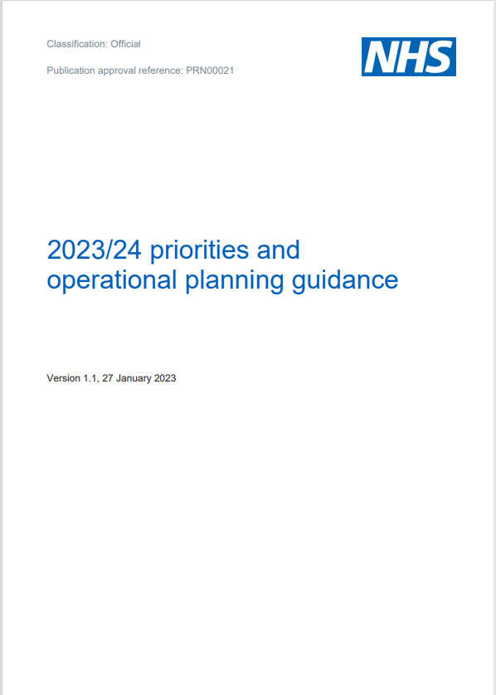
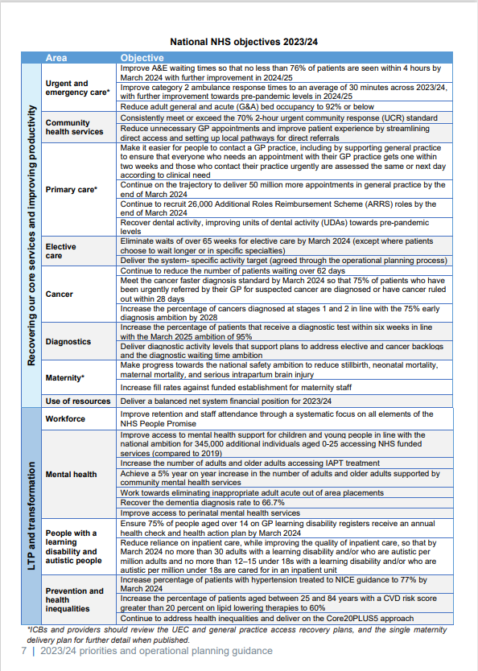
NHS 2023/24 priorities
PRN00021-23-24-priorities-and-operational-planning-guidance-v1.1.pdf (england.nhs.uk)
CSP North West Regional Network May 2023
Notes:
PRN00021-23-24-priorities-and-operational-planning-guidance-v1.1.pdf (england.nhs.uk)

Slide 5
NHS 2023/24 priorities
PRN00021-23-24-priorities-and-operational-planning-guidance-v1.1.pdf (england.nhs.uk)
CSP North West Regional Network May 2023
Notes:
Additional notes
North West priorities (NHS England - Workforce, Training & Education)
Urgent and emergency care
Elective recovery
Mental health, learning disability & autism
Primary care
Maternity
Cancer
Children & young people
Community health services

Slide 6

Elective recovery
Increase capacity:
Growing and supporting the workforce
Using digital technology and data systems to free up capacity
Effective use of independent sector capacity
Prioritising treatment:
Clinical prioritisation
Managing long waits
Urgent referrals for cancer
Transforming the way we provide elective care:
Expanding community diagnostic centres
Increasing surgical capacity through surgical hubs
Improving patient pathways to reduce avoidable delays
Improving access to specialist advice
Making outpatient care more personalised
Better information and support to patients:
Targeted support for patients
Supporting patients to prepare for surgery
C1466-delivery-plan-for-tackling-the-covid-19-backlog-of-elective-care.pdf (england.nhs.uk)
CSP North West Regional Network May 2023
Notes:
C1466-delivery-plan-for-tackling-the-covid-19-backlog-of-elective-care.pdf (england.nhs.uk)
Community diagnostic centres
Government plan to roll out 160 centres by 2025.
One-stop shops offer a range of diagnostic checks, scans and tests closer to home
Reduce the number of hospital visits and reduce waiting times for patients by diverting people away from hospitals – so hospitals can focus on treating urgent patients while the diagnostic centres focus on tackling the backlog for tests and checks.
Operational CDCs in the North West:
Bolton (Bolton South East)
Clatterbridge (Eastham Wirral)
Clatterbridge Arrowe Park (Wirral West)
Ellesmere Port (Ellesmere Port & Neston)
Liverpool Women’s Hospital (Liverpool Riverside)
Manchester & Trafford (Manchester Withington)
Northern Care Alliance – multi-site (Salford & Eccles)
North Care Alliance – Oldham (Oldham West)
Preston Healthport (Preston)
Rossendale (Rossendale & Darwen)
St Helens (St Helens South & Whiston)
Victoria Infirmary Northwich (Weaver Vale)
Westmorland (Westmorland & Lonsdale)
Whitegate Drive (Blackpool North & Cleveleys)

Slide 7

Urgent and emergency care
Increasing urgent and emergency care capacity: additional hospital bed capacity, increasing ambulance capacity, and improving process and standardising care
Increase workforce size and flexibility
Speeding up discharge: improving joint discharge processes, and scaling up intermediate care and social care services
Expanding care outside hospital: scaling urgent community response, frailty and falls services, and expanding virtual wards
Making it easier to access the right care
B2034-delivery-plan-for-recovering-urgent-and-emergency-care-services.pdf (england.nhs.uk)
CSP North West Regional Network May 2023
Notes:
B2034-delivery-plan-for-recovering-urgent-and-emergency-care-services.pdf (england.nhs.uk)
Additional notes
Adult Social Care Discharge Fund: £300 million will be given to integrated care boards (ICBs) to improve bed capacity and £200 million for local authorities to bolster the social care workforce, increasing capacity to take on more patients from hospitals.
Details of £500 million discharge fund - GOV.UK (www.gov.uk)
Additional £250 million:
The additional £200 million - on top of the £500 million Adult Social Care Discharge Fund already announced which reached the frontline in December and is already helping discharge people more quickly - will fund maximum stays of up to 4 weeks per patient until the end of March. Integrated care boards - organisations that arrange health services in each local area - will begin booking beds that are most appropriate to patients’ needs.
Additional £50 million in capital funding to expand hospital discharge lounges and ambulance hubs.
Up to £250 million to speed up hospital discharge - GOV.UK (www.gov.uk)

Slide 8

Primary care recovery plan
Empower patients by rolling out tools they can use to manage their own health, and invest up to £645 million over two years to expand services offered by community pharmacy
Implement ‘Modern General Practice Access’
Build capacity so practices can offer more appointments from more staff than ever before.
Cut bureaucracy to give practice teams more time to focus on their patients’ clinical needs.
Delivery plan for recovering access to primary care (england.nhs.uk)
CSP North West Regional Network May 2023
Notes:
Delivery plan for recovering access to primary care (england.nhs.uk)
The future of general practice (parliament.uk)
Additional notes
What does our AHP Primary Care workforce look like in the North West?
Dietitians, Occupational Therapists, Paramedics, Physiotherapists and Podiatrists
Essentially, the lines are going upwards! We know the data has limitations!
Approx. 2/3rds employ at least one AHP (110/163 PCNs)
PCN Workforce Data (Feb 23) ~303wte
GP Workforce Data (Feb 23) ~ 60wte
Some of our challenges & opportunities:
Flow of workforce into primary care roles
FCP: supervision, uptake of funded FCP modules, FCP to ACP progression
Pre-registration training
Service delivery models – what does ‘good’ look like?
Avoiding silos and duplication
Leadership
Outcomes and demonstrating value (the mega metaphorical biscuit!)
Integration of primary and community care services
Enhanced health in care homes framework:
Enhanced primary and community care support
MDT support including coordinated health and social care
Falls prevention, reablement and rehabilitation including strength and balance
High quality palliative and end-of-life, mental health and dementia care
Workforce development
Data, IT and technology
Levers:
Primary care system development funding (SDF)
Increased flexibility of Additional Roles Reimbursement scheme (ARRS):
increasing the cap on Advanced Practitioners per PCN
reimbursing PCNs for the time that First Contact Practitioners spend out of practice undertaking education and training to become Advanced Practitioners.
increasing the ARRS maximum reimbursement rates for 2022/23 to account for the Agenda for Change uplift*
Fuller stocktake:
Three essential offers:
Streamlining access to care and advice for people who get ill but only use health services infrequently: providing them with much more choice about how they access care and ensuring care is always available in their community when they need it
providing more proactive, personalised care with support from a multidisciplinary team of professionals to people with more complex needs, including, but not limited to, those with multiple long-term conditions
helping people to stay well for longer as part of a more ambitious and joined-up approach to prevention.
Community rehabilitation standards:
Community rehabilitation (csp.org.uk)
Rehab on track: community rehabilitation best practice standards | The Chartered Society of Physiotherapy (csp.org.uk)

Slide 9
On the horizon…
Major Conditions Strategy
  Cancers
  Cardiovascular diseases, including stroke and diabetes
  Chronic respiratory diseases
  Dementia
  Mental ill health
  Musculoskeletal disorders
NHS Long Term Workforce Plan
House of Lords Special Inquiry Committee on the integration of primary and community care
UK COVID-19 inquiry
Modernising the physiotherapy career framework
CSP North West Regional Network May 2023

Slide 10



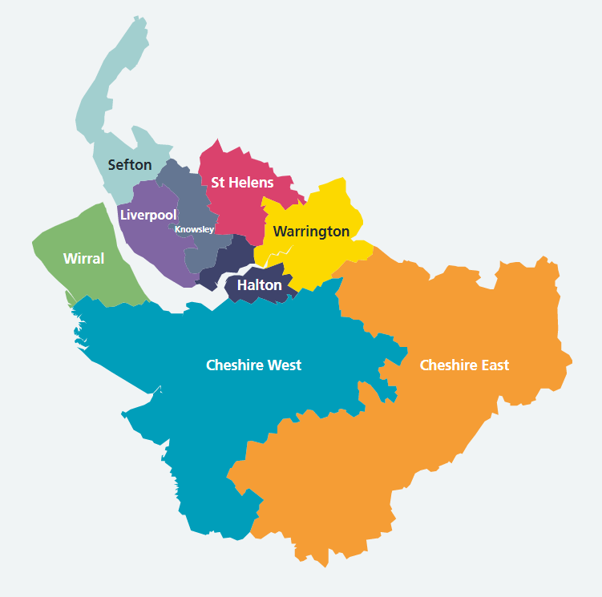
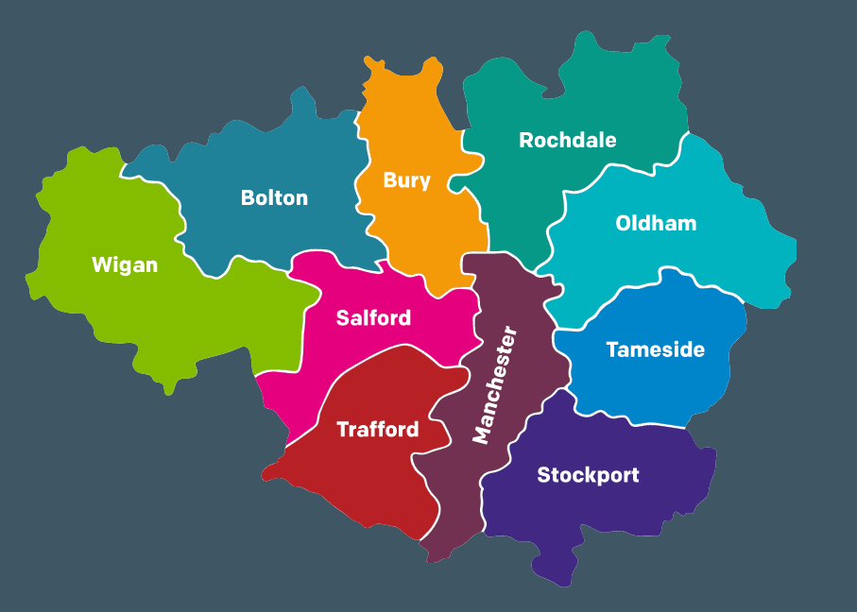
“This must be the place…”
Blackburn with Darwen
Blackpool
South Cumbria
Lancashire
CSP North West Regional Network May 2023
Notes:
Home - NHS Cheshire and Merseyside
Home | Greater Manchester Integrated Care Partnership (gmintegratedcare.org.uk)
LSC Integrated Care Board :: Home (icb.nhs.uk)

Slide 11
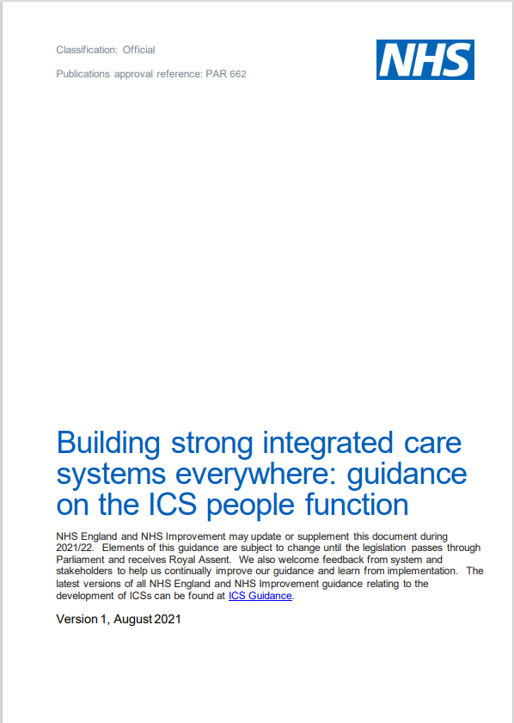
Responsibilities of ICBs
Supporting the health and wellbeing of all staff
Growing the workforce for the future and enabling adequate workforce supply
Supporting inclusion and belonging for all, and creating a great experience for staff
Valuing and supporting leadership at all levels, and lifelong learning
Leading workforce transformation and new ways of working
Educating, training and developing people, and managing talent
Driving and supporting broader social and economic development
Transforming people services and supporting the people profession
Leading coordinated workforce planning using analysis and intelligence
Supporting system design and development
https://www.england.nhs.uk/wp-content/uploads/2021/06/B0662_Building-strong-integrated-care-systems-everywhere-guidance-on-the-ICS-people-function-August-2021.pdf
CSP North West Regional Network May 2023
Notes:
Report template - NHSI website (england.nhs.uk)

Slide 12
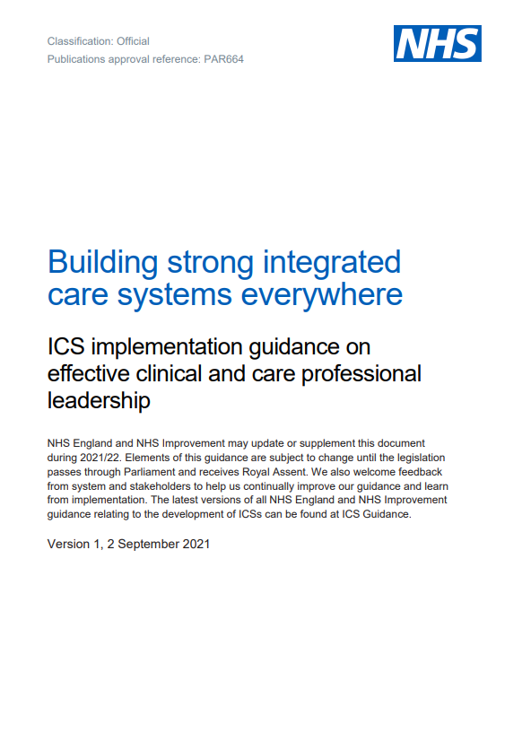
Responsibilities of ICBs
Principle 1: Integrating clinical and care professionals in decision-making at every level of the ICS
Principle 2: Creating a culture of shared learning, collaboration and innovation, working alongside patients and local communities
Principle 3: Ensuring clinical and care professional leaders have appropriate resources to carry out their system role(s)
Principle 4: Providing dedicated leadership development for all clinical and care professional leaders
Principle 5: Identifying, recruiting and creating a pipeline of clinical and care professional leaders
B0664-ics-clinical-and-care-professional-leadership.pdf (england.nhs.uk)
CSP North West Regional Network May 2023
Notes:
B0664-ics-clinical-and-care-professional-leadership.pdf (england.nhs.uk)

Slide 13



Responsibilities of ICBs
CSP North West Regional Network May 2023
Notes:
Additional notes
Greater population health focus on through prevention and early intervention
Tackling health inequalities and improving quality and experiences
Strengthening communities – starting well, living well
Building capacity through integrated neighbourhood teams – strengthening places and neighbourhoods
Value for money and achieving financial stability and sustainability

Slide 14
Physiotherapy workforce in the North West
Staff in post: ~3,800 wte (4,300 headcount)
  30% growth in the workforce over the past 6 years
Age: Average age 38 and age >55 (retirement risk) ~5.2%
Nationality: UK 90%, EU/EEA 5%, ROW 5%
Gender: 75% of workforce female
Disability: 5% report a disability (*but ~10% not declared)
Ethnicity: 10% BME (compared to 15% nationally for physiotherapy)
  Representativeness of local population (C&M PR 8.45% WFR 5.85% / GM PR 15.02% WFR 7.28% / L&SC PR 3.97% WFR 4.57%)
  Diversity diminishes through the bandings
Banding profile: Band 5 17%, Band 6 38%, Band 7 30%, Band 8+ 15%
Sickness rate: ~4.0% (compared to 2018 average ~2.5%): key issues mental health (24%) and MSK (15%)
*Secondary care workforce statistics (May 2023)
CSP North West Regional Network May 2023
Notes:
Statistics:
National (physiotherapy): 15% BAME
North West (physiotherapy): 10% BAME
National (AHP): 16% BAME
North West (AHP): 11% BAME
North West Physiotherapy:
~3,800 wte (4,300 headcount)
Average age 38
Age >55 5.2%
Nationality: UK 90%, EU/EEA 5% ROW 5%
Banding profile: B5 17%, B6 38%, B7 30%, B8+ 15%
30% growth in the workforce over the past 6 years
¾ workforce female
5% report a disability (but ~10% not declared)
Representativeness compared to local population:
C&M: PR 8.45% WFR 5.85%
GM: PR 15.02% WFR 7.28%
L&SC: PR 3.97% WFR 4.57%
Sickness rate: ~4.0% (compared to 2018 average ~2.5%).
North west (AHPs): 5.6%
North west (all): 6.5%
National average (physiotherapy): 3.7%.
National average (AHPs): 5.0%
National average (all): 5.7%
Mental health accounts for 24% of absences. MSK 15%

Slide 15
Our role as anchor institutions
The NHS Long Term Plan and 2020/21 NHS People Plan both outlined ambitions for the NHS to create opportunities for people from more deprived areas to enter employment within the health sector by:
Expanding apprenticeships
Providing routes into employment for volunteers
Working more closely with schools, colleges and universities
2017/18 data of proportion of local jobs within NHS provider organisations
Cheshire & Merseyside 5.93%
Greater Manchester 6.12%
Lancashire & South Cumbria 4.46%
Anchor institutions and how they can affect people's health | The King's Fund (kingsfund.org.uk)
The economic influence of the NHS at the local level | The King's Fund (kingsfund.org.uk)
CSP North West Regional Network May 2023
Notes:
Additional notes
Expand on volunteering opportunities
Refer to local population demographics
Level 6 degree apprenticeship training providers in the north of England:
Physiotherapy, BSc (Hons) - Degree Apprenticeship – UCLan
Physiotherapy (Physiotherapist Degree Apprenticeship) | University of Salford
BSc Physiotherapy | Sheffield Hallam University (shu.ac.uk)
Physiotherapy (Degree Apprenticeship) BSc(Hons) (hud.ac.uk)
Physiotherapy Degree Apprenticeship course | Teesside University
CSP position statement:
Routes into physiotherapy (csp.org.uk)
CSP position statement on apprenticeships - FINAL.pdf

Slide 16

Providing a route in a career in healthcare
T Levels | The Next Level Qualification
CSP North West Regional Network May 2023
Notes:
Additional notes
Signposting to local exemplars: East Lancashire Hospitals NHS Trust; Tameside & Glossop Integrated Care NHS Foundation Trust
Pathways into employment and further training

Slide 17

Physiotherapy support workforce
https://www.hee.nhs.uk/our-work/allied-health-professions/enable-workforce/developing-role-ahp-support-workers
Allied Health Profession (AHP) Support Worker Competency, Education and Career Development Framework
Readiness toolkit
Grow your own workforce strategies
Making learning work for support workers
Education qualification mapping tool
Supervision, accountability and delegation of activities
Nationally-led procurement for Level 3 Senior Healthcare Support Worker apprenticeship and Level 5 Assistant Practitioner apprenticeship training providers
Natalie Bradley, Apprenticeship Relationship Manager, NHS England – North West natalie.bradley@hee.nhs.uk
National AHP Support Workforce programme team ahp.supportworkforce@hee.nhs.uk
CSP North West Regional Network May 2023
Notes:
Additional notes
To find out more about local and national training providers for Level 3 and Level 5 AHP support worker apprenticeships contact your either your ICS AHP workforce lead, natalie.bradley@hee.nhs.uk, or gareth.cornell@hee.nhs.uk.

Slide 18

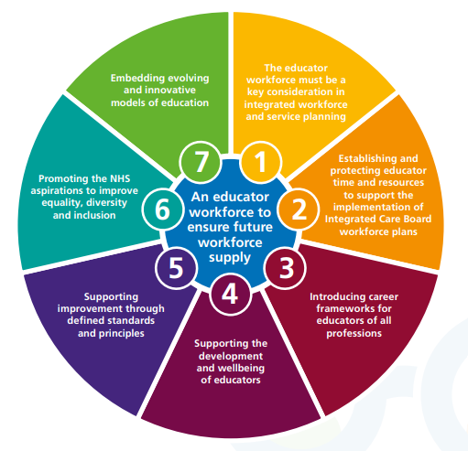
Education capacity & capability
Educator Workforce Strategy (hee.nhs.uk)
CSP North West Regional Network May 2023
Notes:
Educator Workforce Strategy (hee.nhs.uk)

Slide 19
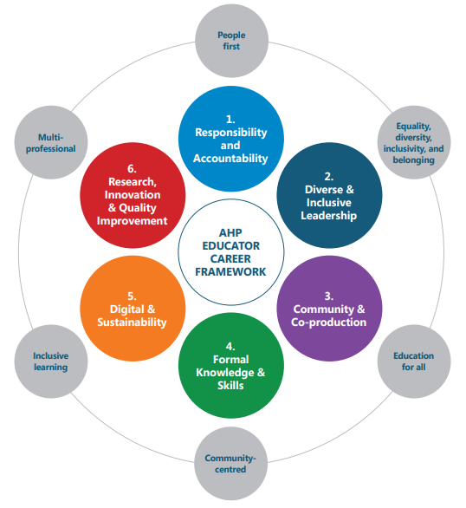

Education capacity & capability
Allied-Health-Professions-Educator-Framework.pdf (councilofdeans.org.uk)
CSP North West Regional Network May 2023
Notes:
Allied-Health-Professions-Educator-Framework.pdf (councilofdeans.org.uk)
Additional notes
Council of Deans of Health release new report, Anti-racism in AHP Education: Building an Inclusive Environment. | Council of Deans of Health
Guidance: Public Health Content within the Pre-Registration Curricula for Allied Health Professions | Council of Deans of Health
Report: Becoming research confident – research placements in pre-registration nursing, midwifery and allied health programmes in the UK | Council of Deans of Health
New Report: AHP Leadership in Academia: opportunities, challenges and current positioning | Council of Deans of Health
Allied Health Professions’ Research and Innovation Strategy for England | Health Education England (hee.nhs.uk)
Modernising pre-registration physiotherapy education | The Chartered Society of Physiotherapy (csp.org.uk)

Slide 20
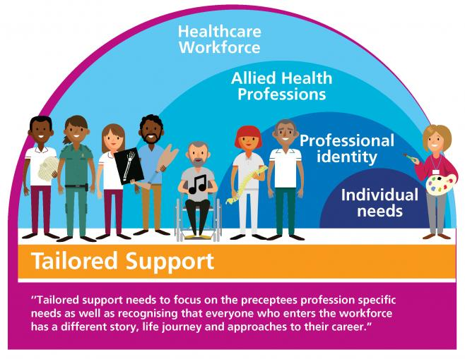
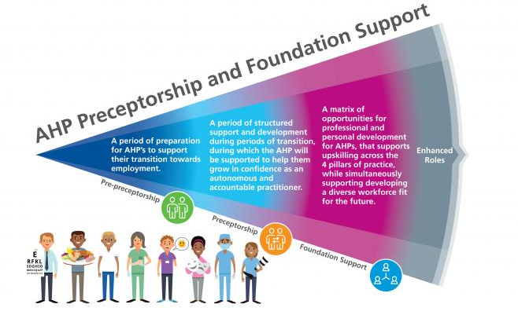
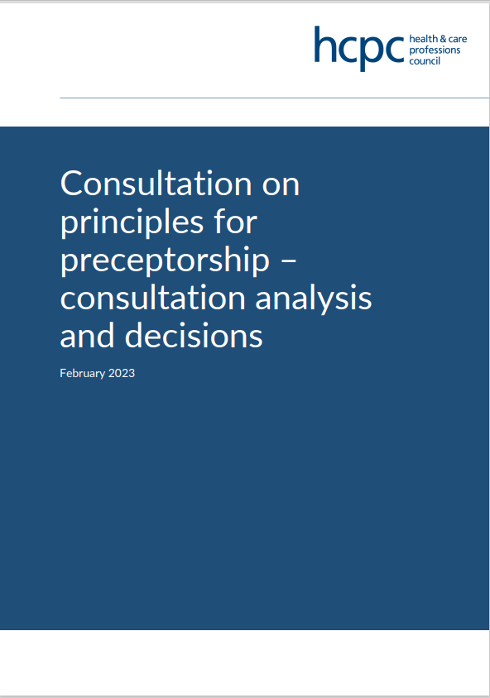

Supporting new graduates
National AHP Preceptorship and Foundation Support | Health Education England (hee.nhs.uk)
Step to Work - elearning for healthcare (e-lfh.org.uk)
CSP North West Regional Network May 2023
Notes:
Additional notes
Downstream outputs from national preceptorship programmes (expected later this year):
Preceptor resources
Implementation framework
HCPC retention rates publications: Retention rates of first time HCPC registrants, 2013 to 2018 | (hcpc-uk.org)
CSP and other resources:
Preceptorship | The Chartered Society of Physiotherapy (csp.org.uk)
Preceptorship and the four pillars of practice | The Chartered Society of Physiotherapy (csp.org.uk)
Preceptorship case studies | The Chartered Society of Physiotherapy (csp.org.uk)
Flying Start NHS® | Turas | Learn
There is a need to better understand the flow of new graduates into the local employment market

Slide 21

Retention
NHS England » Our NHS People Promise
NHS England » Looking After Our People – Retention hub
CSP North West Regional Network May 2023
Notes:
NHS England » Our NHS People Promise
NHS England » Looking After Our People – Retention hub
NHS England » Nursing and midwifery retention self-assessment tool
Improving staff retention | NHS Employers
Working together to improve NHS staff experiences | NHS Staff Survey (nhsstaffsurveys.com)

Slide 22

Equality, diversity, inclusion & belonging
NHS England » Equality, diversity and health inequalities
Health and social care review: leadership for a collaborative and inclusive future - GOV.UK (www.gov.uk)
'A long way to go': ethnic minority NHS staff share their stories (kingsfund.org.uk)
CAHPO Black, Asian and Minority Ethnic (BAME) Strategic Advisory Groups
CSP North West Regional Network May 2023
Notes:
NHS England — North West » North West Equality, Diversity and Inclusion Portal
Statistics:
National (physiotherapy): 15% BAME
North West (physiotherapy): 10% BAME
National (AHP): 16% BAME
North West (AHP): 11% BAME
North West Physiotherapy:
~3,800 wte (4,300 headcount)
Average age 38
Age >55 5.2%
Nationality: UK 90%, EU/EEA 5% ROW 5%
Banding profile: B5 17%, B6 38%, B7 30%, B8+ 15%
30% growth in the workforce over the past 6 years
¾ workforce female
5% report a disability (but ~10% not declared)
Representativeness compared to local population:
C&M: PR 8.45% WFR 5.85%
GM: PR 15.02% WFR 7.28%
L&SC: PR 3.97% WFR 4.57%
Sickness rate: ~4.0% (compared to 2018 average ~2.5%).
North west (AHPs): 5.6%
North west (all): 6.5%
National average (physiotherapy): 3.7%.
National average (AHPs): 5.0%
National average (all): 5.7%
Mental health accounts for 24% of absences. MSK 15%

Slide 23
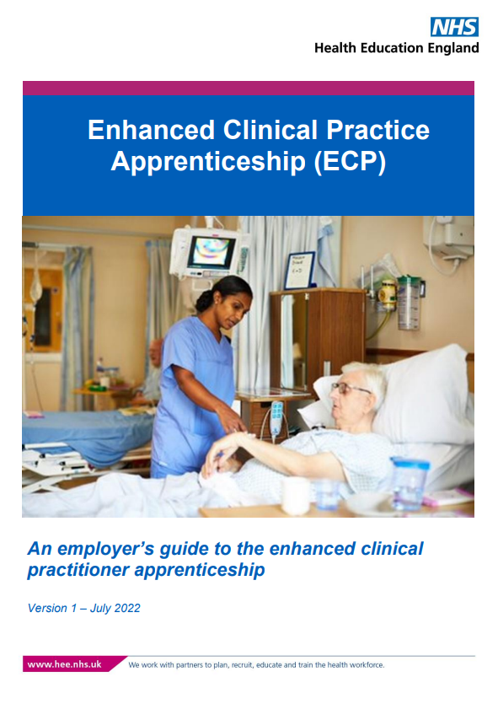
Enhanced Practice
University of Salford
Coventry University
Sheffield Hallam University
Institute of Osteopathy
Enhanced practice | Health Education England (hee.nhs.uk)
Enhanced clinical practitioner / Institute for Apprenticeships and Technical Education
Enhanced Clinical Practitioner Apprenticeship Guide - HASO (skillsforhealth.org.uk)
CSP North West Regional Network May 2023
Notes:
Enhanced practice | Health Education England (hee.nhs.uk)

Slide 24


Advanced & Consultant Practice
Credentials:
Acute medicine
Autism
Community-based rehabilitation: Healthy ageing
Community-based rehabilitation: Physical activity for people with long-term conditions
End-of-life care
Learning disability
Mental health
Musculo-skeletal conditions
Neurological rehabilitation
Older people
Pelvic health
Public health
Surgery
Advanced Practice Toolkit - elearning for healthcare (e-lfh.org.uk)
https://advanced-practice.hee.nhs.uk/
Reports and publications - Advanced Practice (hee.nhs.uk)
CSP North West Regional Network May 2023

Slide 25
Workforce enablers
Workforce planning, transformation & redesign tools:
  https://recipeforworkforceplanning.hee.nhs.uk/
  https://www.skillsforhealth.org.uk/info-hub/six-steps-methodology-to-integrated-workforce-planning/
  HEE Star: Accelerating workforce redesign | Health Education England
  Clinically-Led workforcE and Activity Redesign (CLEAR) | Health Education England (hee.nhs.uk)
  Multidisciplinary Team (MDT) Toolkit | Health Education England (hee.nhs.uk)
  Staffing Evaluation System for Leaders (SESL) toolkit | The Chartered Society of Physiotherapy (csp.org.uk)
  NHS England » The Model Health System
Job planning: NHS England » Allied health professionals job planning: a best practice guide
Demand-capacity modelling: NHS England » Demand and capacity models
Workforce data: National Workforce Data Set (NWD) guidance documents - NHS Digital
Developing local and system workforce strategy: supply, recruitment, retention strategies
Upskilling, apprenticeships, capability frameworks and career pathways
Digital capability and transformation:
  A plan for digital health and social care - GOV.UK (www.gov.uk)
  A Digital Framework for Allied Health Professionals (england.nhs.uk)
  Profession and Service Specific Digital Capabilities Frameworks | Digital Transformation (hee.nhs.uk)
  Physiotherapy Health Informatics Strategy vision | The Chartered Society of Physiotherapy (csp.org.uk)
CSP North West Regional Network May 2023

Slide 26
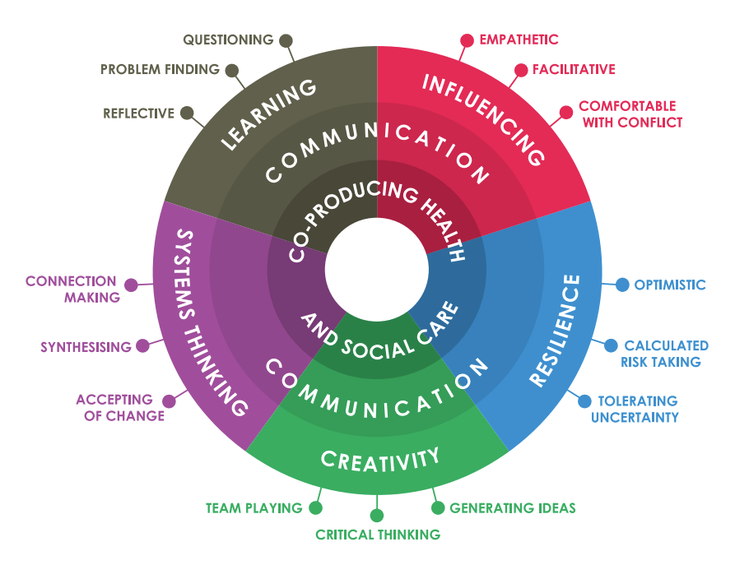
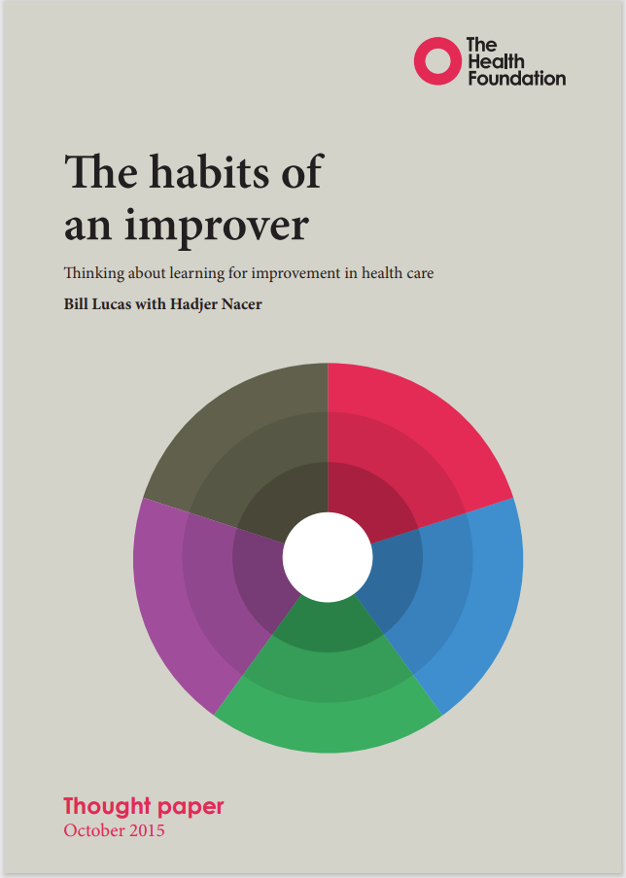
Change starts with you…
https://www.health.org.uk/sites/default/files/TheHabitsOfAnImprover.pdf
CSP North West Regional Network May 2023
Notes:
The habits of an improver (health.org.uk)
https://www.health.org.uk/sites/default/files/TheHabitsOfAnImprover.pdf
Bringing habits, skills and knowledge together
Matching knowledge systems and improvement habits
Habits of the mind – mathematical vs scientific
Building learning power

Slide 27
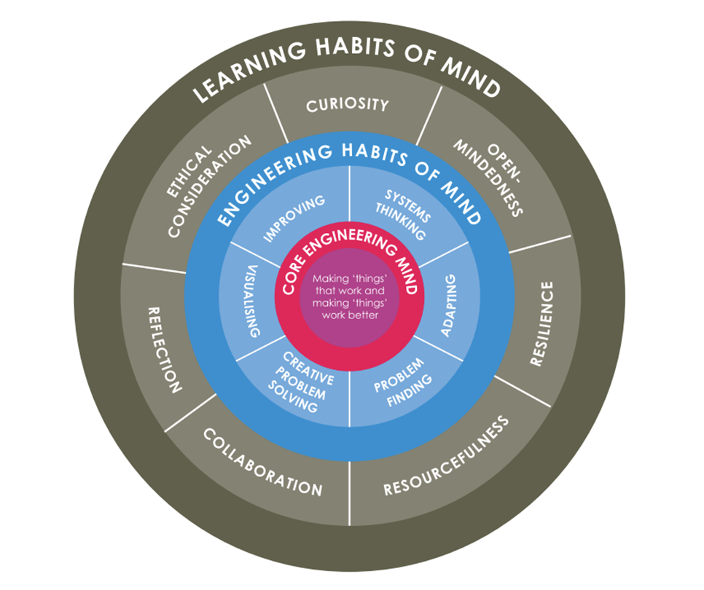
Change starts with you…
https://www.health.org.uk/sites/default/files/TheHabitsOfAnImprover.pdf
CSP North West Regional Network May 2023
Notes:
The habits of an improver (health.org.uk)
https://www.health.org.uk/sites/default/files/TheHabitsOfAnImprover.pdf
Bringing habits, skills and knowledge together
Matching knowledge systems and improvement habits
Habits of the mind – mathematical vs scientific
Building learning power

Slide 28

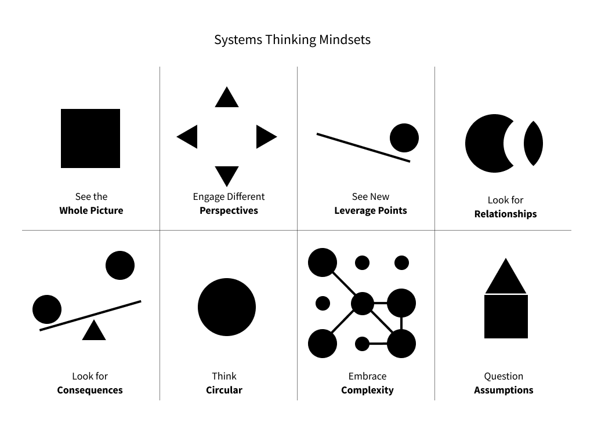




…but requires much and many others
CSP North West Regional Network May 2023

Slide 29


Zooming out and zooming in
CSP North West Regional Network May 2023
Notes:
What is driving change? Why is change needed?
Readiness for change
Who are my stakeholders?
What is driving change?
Improving clinical quality
Promoting equality and tackling inequalities
Financial sustainability challenges
Ensuring workforce stability
Think system-wide.
Speak to others and look for examples that might be relevant.
Consider a range of possibilities.
Understand the current position and readiness for change.
Tests for change:
Strong public and patient involvement
Consistency with current and prospective need for patient choice
Clear evidence-base
Support for proposals from stakeholders (incl. commissioners)
Legal duties:
The National Health Service Act 2006
Equality Act 2010 (Public Sector Equality Duty)
What does this mean? You’ll need to complete an Impact Assessment looking at equalities as part of your service change programme.
A proactive approach to stakeholder partnerships is critical to success.
Differentiate your engagement activity according to your stakeholder map – one size doesn’t fit all
Good engagement takes time, resource, and energy – it can’t be rushed

