Slide 1
BSW Long Covid Assessment and Rehabilitation Clinic
Our service development journey
Jane Clarke
Clinical Lead, bswicb.postcovidpathway@nhs.net
@janeclarkey
bswccg.postcovidpathway@nhs.net

Slide 2
Aims
The Service
What we did
How we did it
Results
Next steps
Reflection

Slide 3
What is Long covid?
Long Covid is the patient's term for Post Covid-19 Syndrome.
Persistent symptoms more than 12 weeks after initial Covid-19 infection.
64% women
35-65 year olds
Often no physical co-morbidity

Slide 4
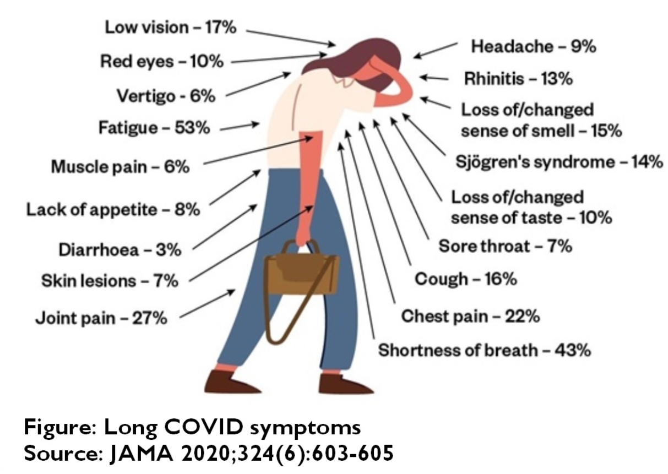
Notes:
Clusters of symptoms;
Immune response – allergy, hayfever, joint inflammation, costochondritis, gastritis, post viral fatigue
Autonomic dysfunction – palpatations, SOB, temperature control issues
Post ICU syndrome, neuropathy, resp complications, unstable diabetes, PTSD
Major organ – very small numbers

Slide 5
Shared agreement
Service spec;
The aim of the BSW Long Covid Community Rehabilitation Service is to provide assessment, signposting and short-term rehabilitation to adult patients in BSW who are experiencing new and long-lasting symptoms of the Covid 19 infection which are significantly impacting how they are able to function in day-to-day life.
Shared mission;
To enable people to get better or learn to live well with Long Covid

Slide 6
Referral Pathway
Screened within 72hours
Accepted for Tel/video/home visit Ax
12 weeks or over since Covid symptoms
GP electronic referral
Symptoms consistent with Covid or positive test
Full blood count within 8 weeks of ref
Chest XR (within 12 weeks) if persistent breathlessness
Secondary Care Referral
Screened within 72hours rejected with reason. If under 12 weeks signposted resources
Aged 16 or older
Appropriate referrals made eg cardiology, respiratory, psychology.

Slide 7
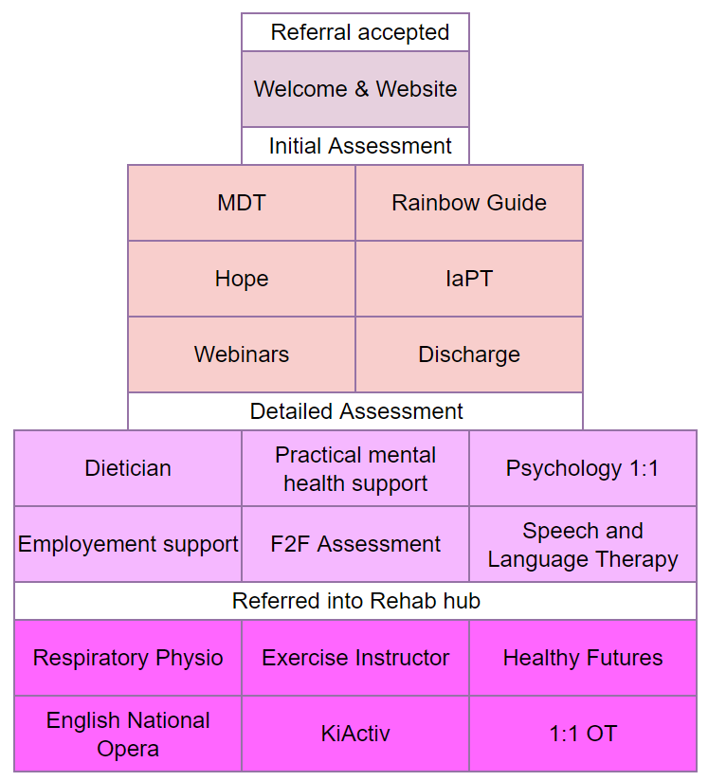
A personalised cake!

Slide 8
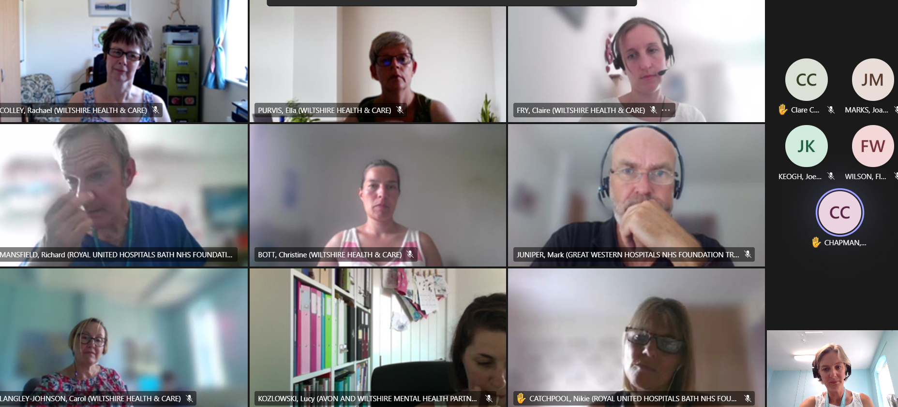
BSW Virtual MDT

Slide 9
Service development audit plan
To identify the prognosis and/or recovery of people with Long Covid.
To identify if there are any characteristics of non-responders to help us better understand the factors that may influence the long-term disability
To identify any “at risk” groups that are not well represented in the patient population.
Healthy Futures (virtual group)
Respiratory Physiotherapy
Patient satisfaction
Employment advisor role
Mental health support
Dietician

Slide 10
Service development - How
Collect outcome measures pre-assessment, 6 months, 12 months
Modified C19 YRS, EQ5D-L GAD7,PHQ9, Symptoms self efficacy questionnaire
Age, gender, ethnicity, deprivation status, co-morbidity, hospitalised
Healthy Futures Pre &Post Ix
(Feedback, C19, GAD7, PHQ9, EQ5D, SSEQ)
Respiratory Physiotherapy
Pre&Post
(Resp rate, Borg at rest, EQ5D, GAD7, PHQ9)
Patient satisfaction
(survey & quali interviews, forum
Employment advisor role
Pre &Post Ix
(work status, SSEQ & feedback)
Mental health support
Pre &Post Ix
(SSEQ, GAD7, PHQ9 & feedback)
Dietician
Pre &Post Ix
(Weight, BMI, SSEQ, & feedback)

Slide 11
Service development - Resources
UWE Research advisor and stats support
Started March, clinician completes questionnaires or admin
June, bought Elaros web/phone app
Admin chasing completion and just launched 6-month data requests.
Healthy Futures
Clinical Psychology PhD student
Respiratory Physiotherapy
MSc Health Psychology student
Patient satisfaction
Physio, volunteer & Comms team
Employment advisor role
? Physio/OT student
Mental health support
MSc Health Psychology student
Dietician
? Dietician student or admin

Slide 12
Results
Mobile app increased completion rates from 76% to 85%
Respiratory Physiotherapy (sample 27)
  Higher rate of co-morbidities 44.8
  Borg, GAD 7, PHQ9, EQ5d and self efficacy all improved (sample 27)
  5 had no change in Borg

Slide 13
Results
Healthy Futures (sample 49)
  Reduction in attendance over 7-week course 85% - 61%
  50% completed pre course questionnaire pack
  87% right length (60 mins)
  Content well received suggested sleep management content
  All but 2 would recommend the group to others.

Slide 14
Patient Interview Feedback
“I’m very happy with my treatment received and appreciate everything the team has done. I understand the difficulty of treating a condition that can only be managed and feel as though the team have done an excellent job.”
Positive
Services mentioned as helpful:
OT, Healthy futures, employer letter, pacing advice
“Felt listened too”
“Good explanations”
“Appreciated PIFU”
“ Very caring”
“Fantastic service”
“Lovely, kind people. Great coordination between specialists in that they share notes and read notes prior to appointment.”
“Everyone on the team and service was really helpful and helped me gain a better understanding of what Long Covid is and how to manage my symptoms.”
Neutral
Appreciates all evolving and no knowledge on long term effects
Appreciates on a steep learning curve
Appreciates times were difficult at the start
Negative
Referred to service too late
Wait time for onward referral was 9 months
Not to blame everything on anxiety
Would have liked face to face

Slide 15
Next steps
Collect 6-month data set and review findings
Complete healthy futures data review (outcome measures)
Identify outcome measures for employment & dietician evaluation

Slide 16
Reflections
Start small
Find a well-respected outcome measure, that is sensitive
Get team buy in

Slide 17

You are vital!
Your diligence,
Your extra 5 minutes,
Ensure our team can start to answer our questions
Helping us to help our future patients

Slide 18
Reflections
Build it into notes system
Utilise students for data collection and analysis
Write down your objectives
Crunch the data and reflect and share, share, share
Gantt chart your milestones

Slide 19
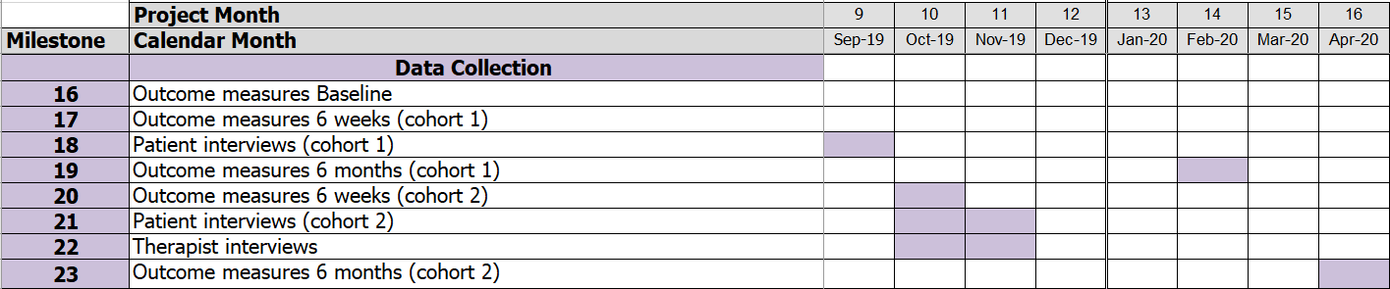
Gantt

Slide 20


Slide 21

Jane Clarke
BSW Long Covid Pathway Lead
bswicb.postcovidpathway@nhs.net
@janeclarkey

Slide 22
