Slide 1
The View From Both Sides
Georgia Jones
3rd Year MMU Student Physiotherapist and Community Support Worker

Slide 2
The View From Both Sides
What would my Support Worker self tell my Student self?
Feel free to ask me any question, there’s no such thing as a silly question– I found that Support Workers on placement often had an in depth understanding of the area I was working in, always willing to share this knowledge
Shadow a Support Worker in each clinical area - Working alongside Support Workers really helped increase my awareness and understanding of the role
It’s normal to feel nervous and unsure in an unfamiliar clinical environment – This was so reassuring on placement, especially when I was first starting and found it very overwhelming, helpful to not assume the students previous experience and ask what they have done
You are a part of the team and your opinion matters – As as student it can be quite stressful moving between trusts and teams for each placement, feeling welcomed and given the opportunity to contribute can make such a difference

Slide 3
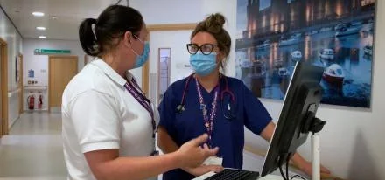
The View From Both Sides
Why is it important for students to understand the role of a support worker?
To assist in transition from student to newly qualified therapist as both will be working together and the registered physiotherapist will be responsible for providing support
Improve patient outcomes as will have a better understanding of the scope of practice
To help eliminate assumptions and misperceptions of the role
What can students learn from support workers?
Patient centred care
Communication skills
Organisation and prioritising workload
Empathy and respect
Service specific knowledge

