Slide 1
CSP NE/ NEMS event
Ruth ten Hove
Practice and Development
CSP
22nd May 2019, St Peters Campus University of Sunderland

Slide 2
What’s changing?
An ageing population;
rise of long-term conditions
& non-communicable diseases
Increasing focus on public
health
Person-centred care: models
of co-production, with greater
on the whole person & self-management
Safe, quality patient care
Patient need
Affordability
Service delivery models
Technology
Rising expectations about
accessibility, quality & outcomes
of care
Human genome;
telecare; health
informatics
Increasing financial
constraint; imperative to
find cost-effective
solutions to meeting rising
demand
Service commissioning – increasing
competition within a growing
plurality of providers
Care closer to home
Increasing accountability for care’s safety,
quality and value for money
Increasing integration of health & social care
More generalist professional roles, less defined
by profession and more by competences

Slide 3


Slide 4



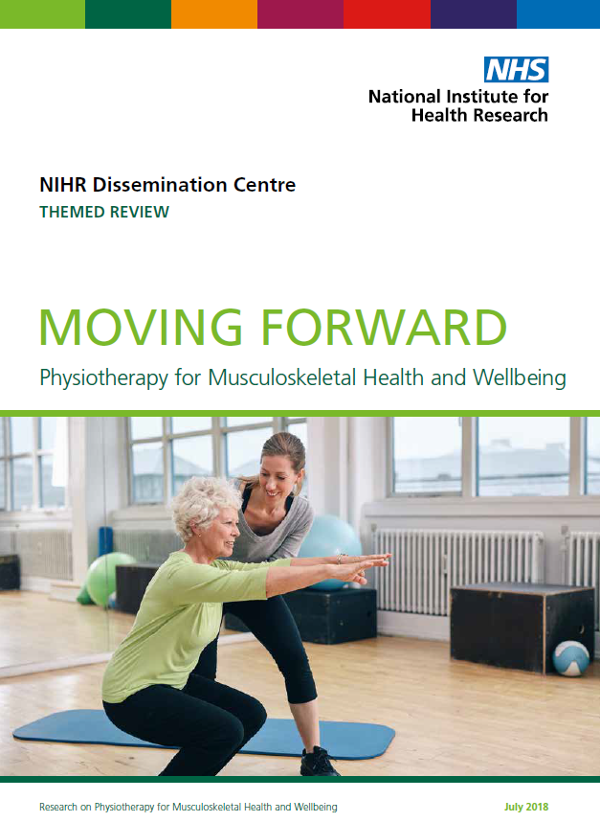

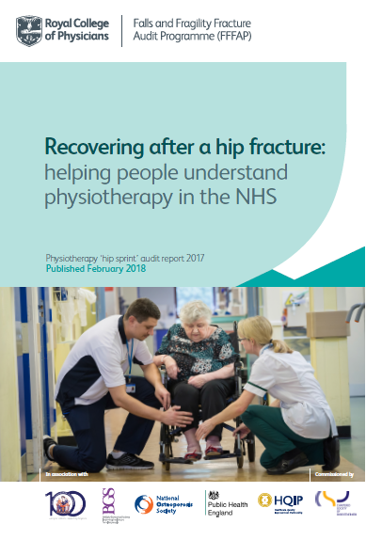
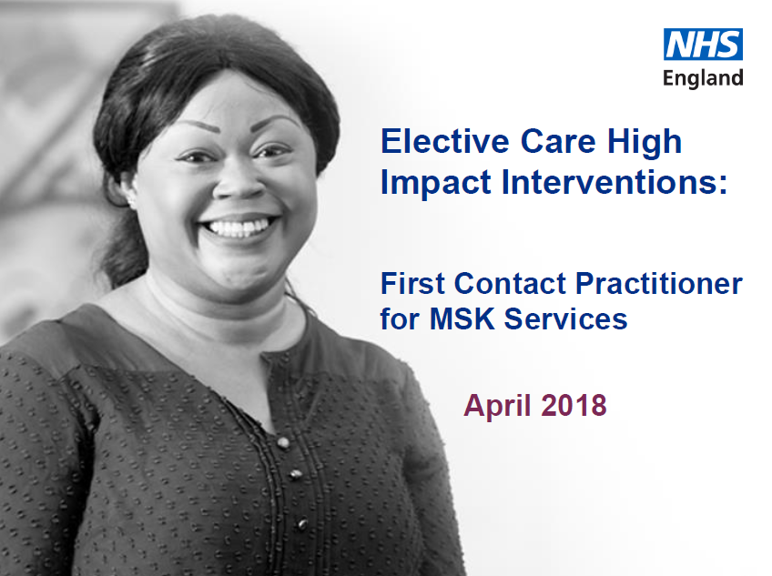
NIHR Signal: Exercise therapy may still improve balance when started a long time after a stroke
RIGHT EVIDENCE, BETTER DECISIONS

Slide 5
NIHR MSK themed review

Slide 6

Programme partners

