Slide 1
'Bounce Back' clinic: A primary care multidisciplinary one stop clinic for frailty
Amanda Hensman-Crook

Slide 2
Frailty
Frailty accounts for the highest use of unplanned admissions, and the highest use of health and social care services
Addressing frailty is embedded in our core capabilities as is case management. Combining our knowledge with the MDT enhances care.

Slide 3

Upstream care
Best to capture people here
Before they get to this point

Slide 4
FCP Solution
Lead by MSK FCP
Fully integrated service with the wider health system
Initally driven by Frailty QOF
Funded by the ICC

Slide 5
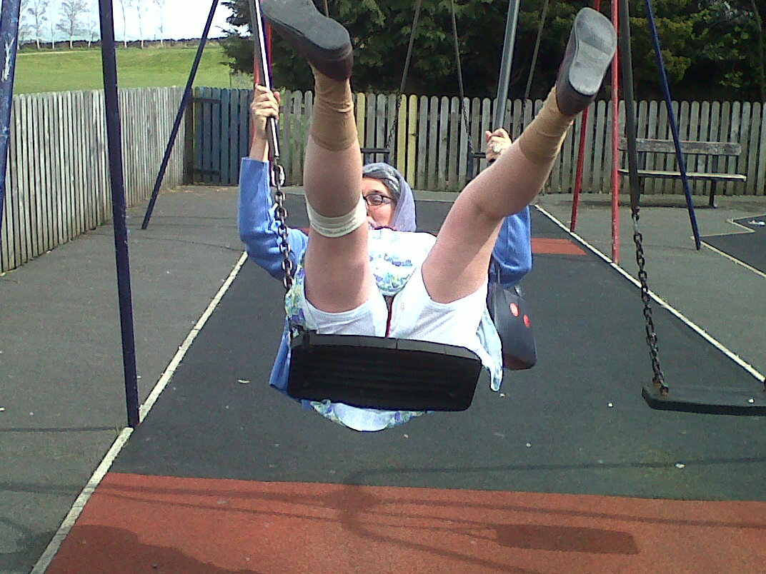
The Bounce Back Clinic
A peripatetic multi disciplinary team one stop frailty clinic in primary care – falls prevention
Physiotherapist - Core strength, mobility and balance
(Otago), on referral.
Nurse – Nursing assessment
Pharmacist – Medication review
Age UK - Support services and home adaptation

Slide 6
Target Patients and referral in
All patients who have had their first fall
Patients who are identified as ‘at risk’ of falling
All primary care, acute and community services have direct referral
Anyone can refer in at GP reception including self referral and relatives/friends with the patients’ consent

Slide 7
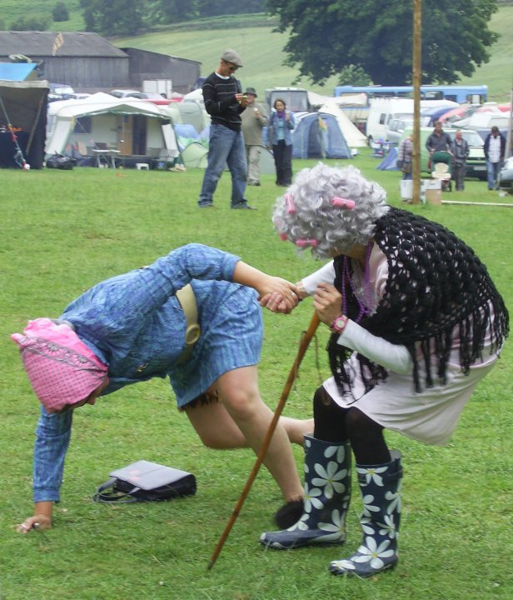
Outcome measures
Patient satisfaction
Edmonton and ConfBal scores
Number of falls in a year
Medication reviews
On referral from Age UK

Slide 8
Results
Patient satisfaction scores 98% excellent & 2% very good
Confbal -100% improvement of reviewed cases with average score increase of 5 (out of 30)
Edmonton 95% improvement of reviewed cases with average 1 point increase and 40% moving into a higher category
52 medicines reduced or stopped and 27 of these potentially linked to falls (in the first 2 months)

Slide 9
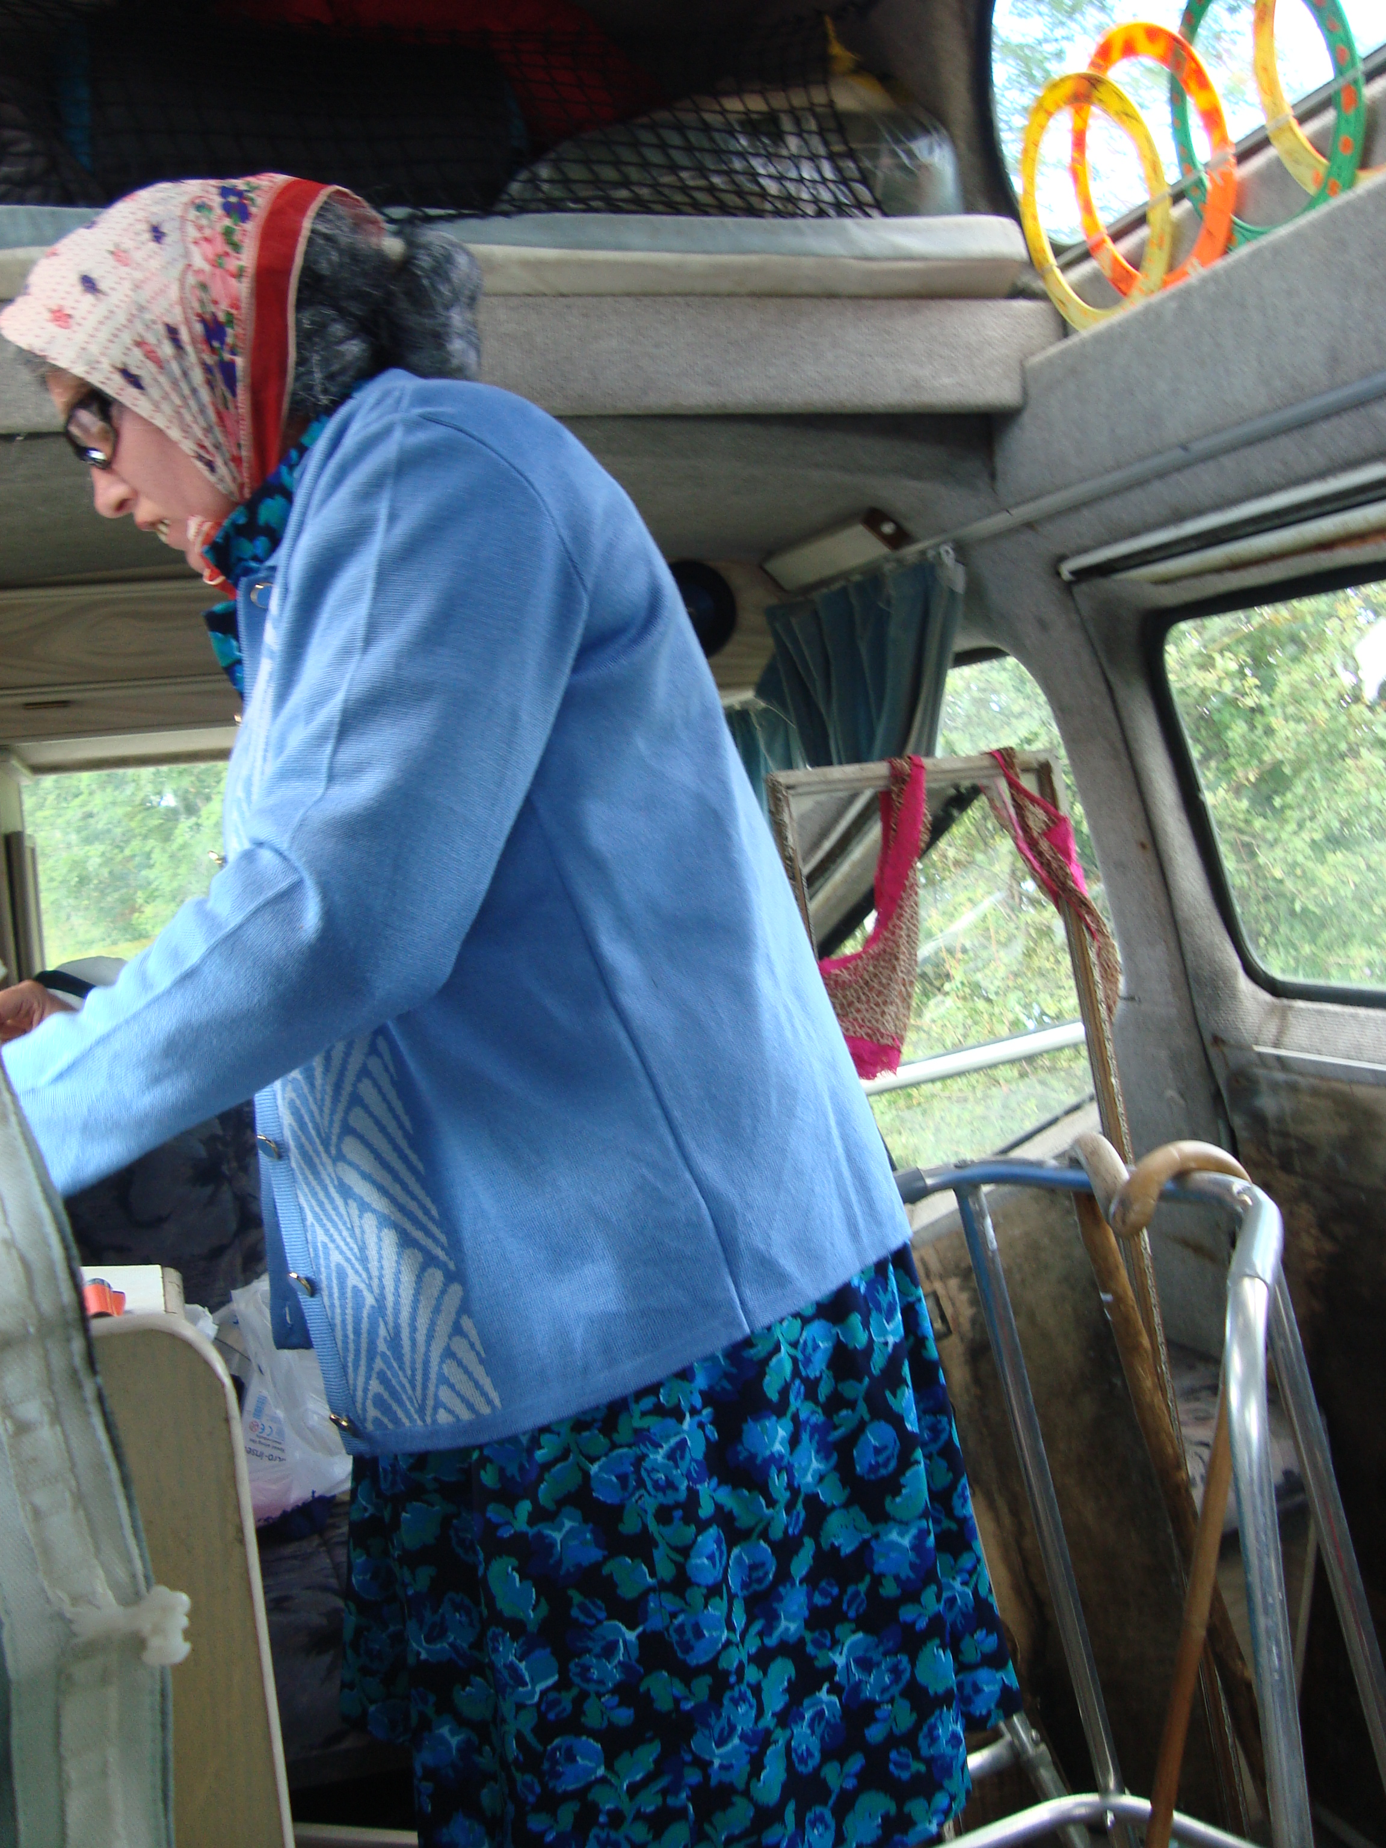
Results 28 patients (2 month audit)
Age UK
15 clients were given advice (local groups/handy man/benfits etc)
13 clients were given further interventions eg home assessment
12 Benefit applications , 10/12 awarded

Slide 10
Outcome from the year Audit
Recommendations made to make the model sustainable
Has been commissioned for another year
Being reproduced regionally Is being piloted in other counties
Has been included in the NHSE Enhanced care in Care Homes

Slide 11
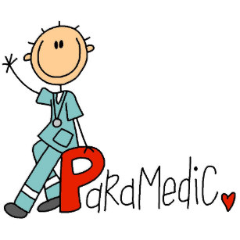
Taking care of the severely frail – rounding the circle
FCP Paramedic mentored by FCP physiotherapist
Feeds in to Case management team
Integration into other services

Slide 12
Conclusion
MDT care works
Physiotherapy provides upstream solutions
Patients like wrap around care close to home
A popular service that has been commissioned for another year locally and been adopted regionally as a wider pilot and nationally

Slide 13
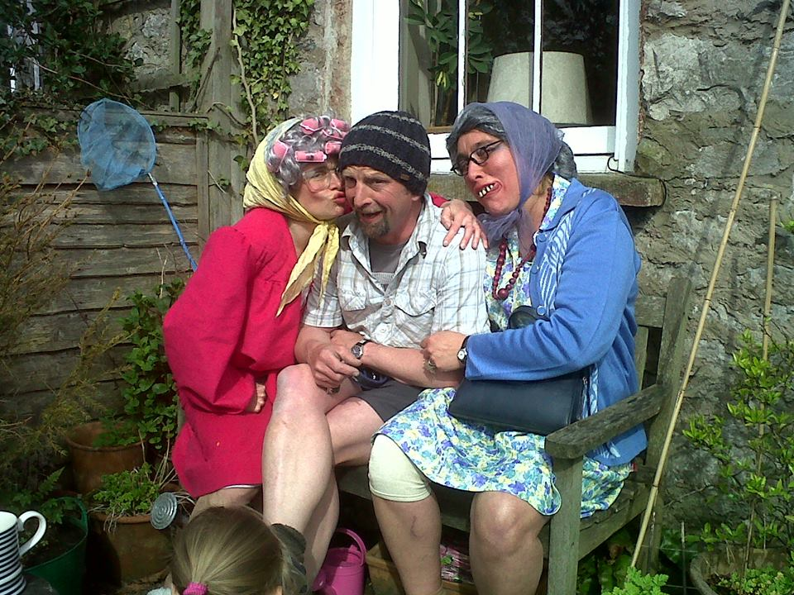
Thank you for listening

